Slide 1
Bio-Adhesives of the future
2023 Maria Garcia, Founder
maria@bindethics.com

Slide 2
What’s the first thing that comes to mind when you hear the word Formaldehyde?

Slide 3
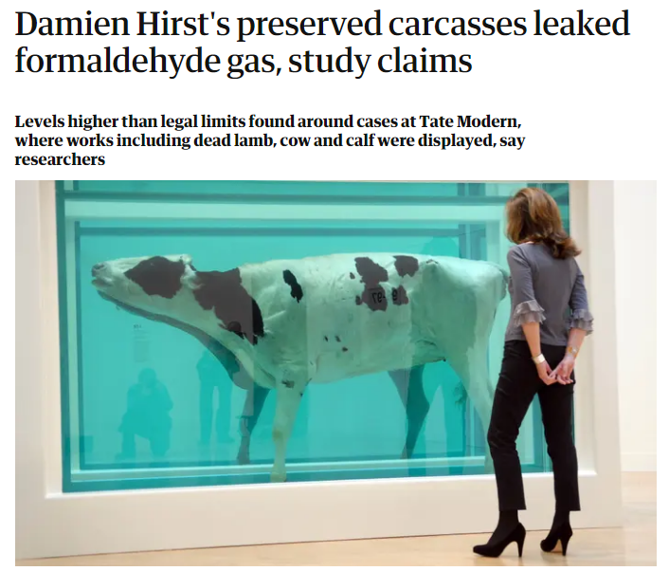
2016
Notes:
Have you heard about formaldehyde? What comes to mind when you hear “formaldehyde”? This is just one example of how formaldehyde is not good news. Not only for the artist but for everyone I have some news for you which is the fact that are exposed to formaldehyde gas on a regular basis. The reason for this is that Formaldehyde is used to make adhesives.

Slide 4
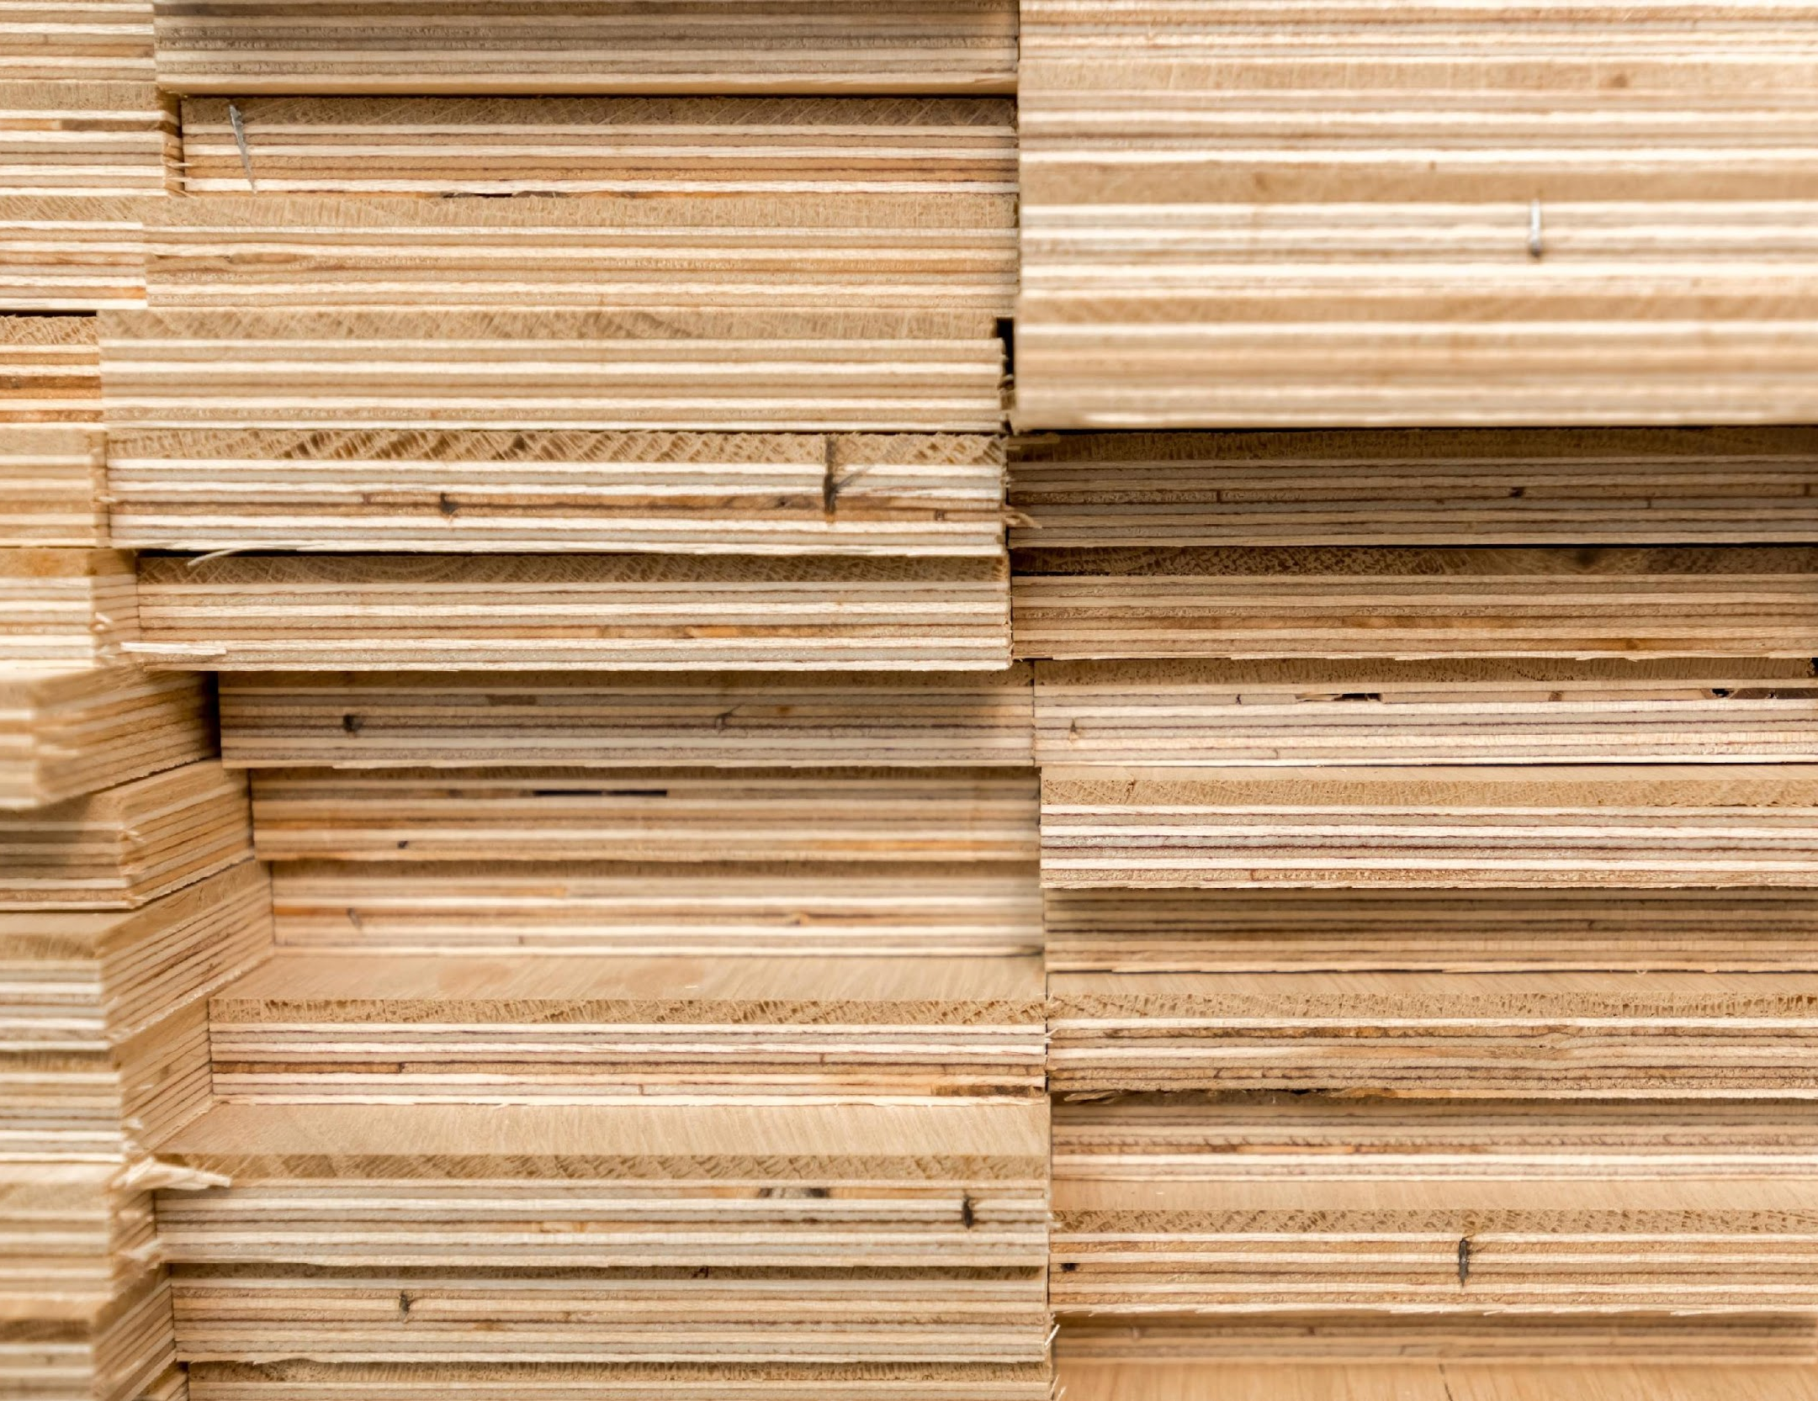
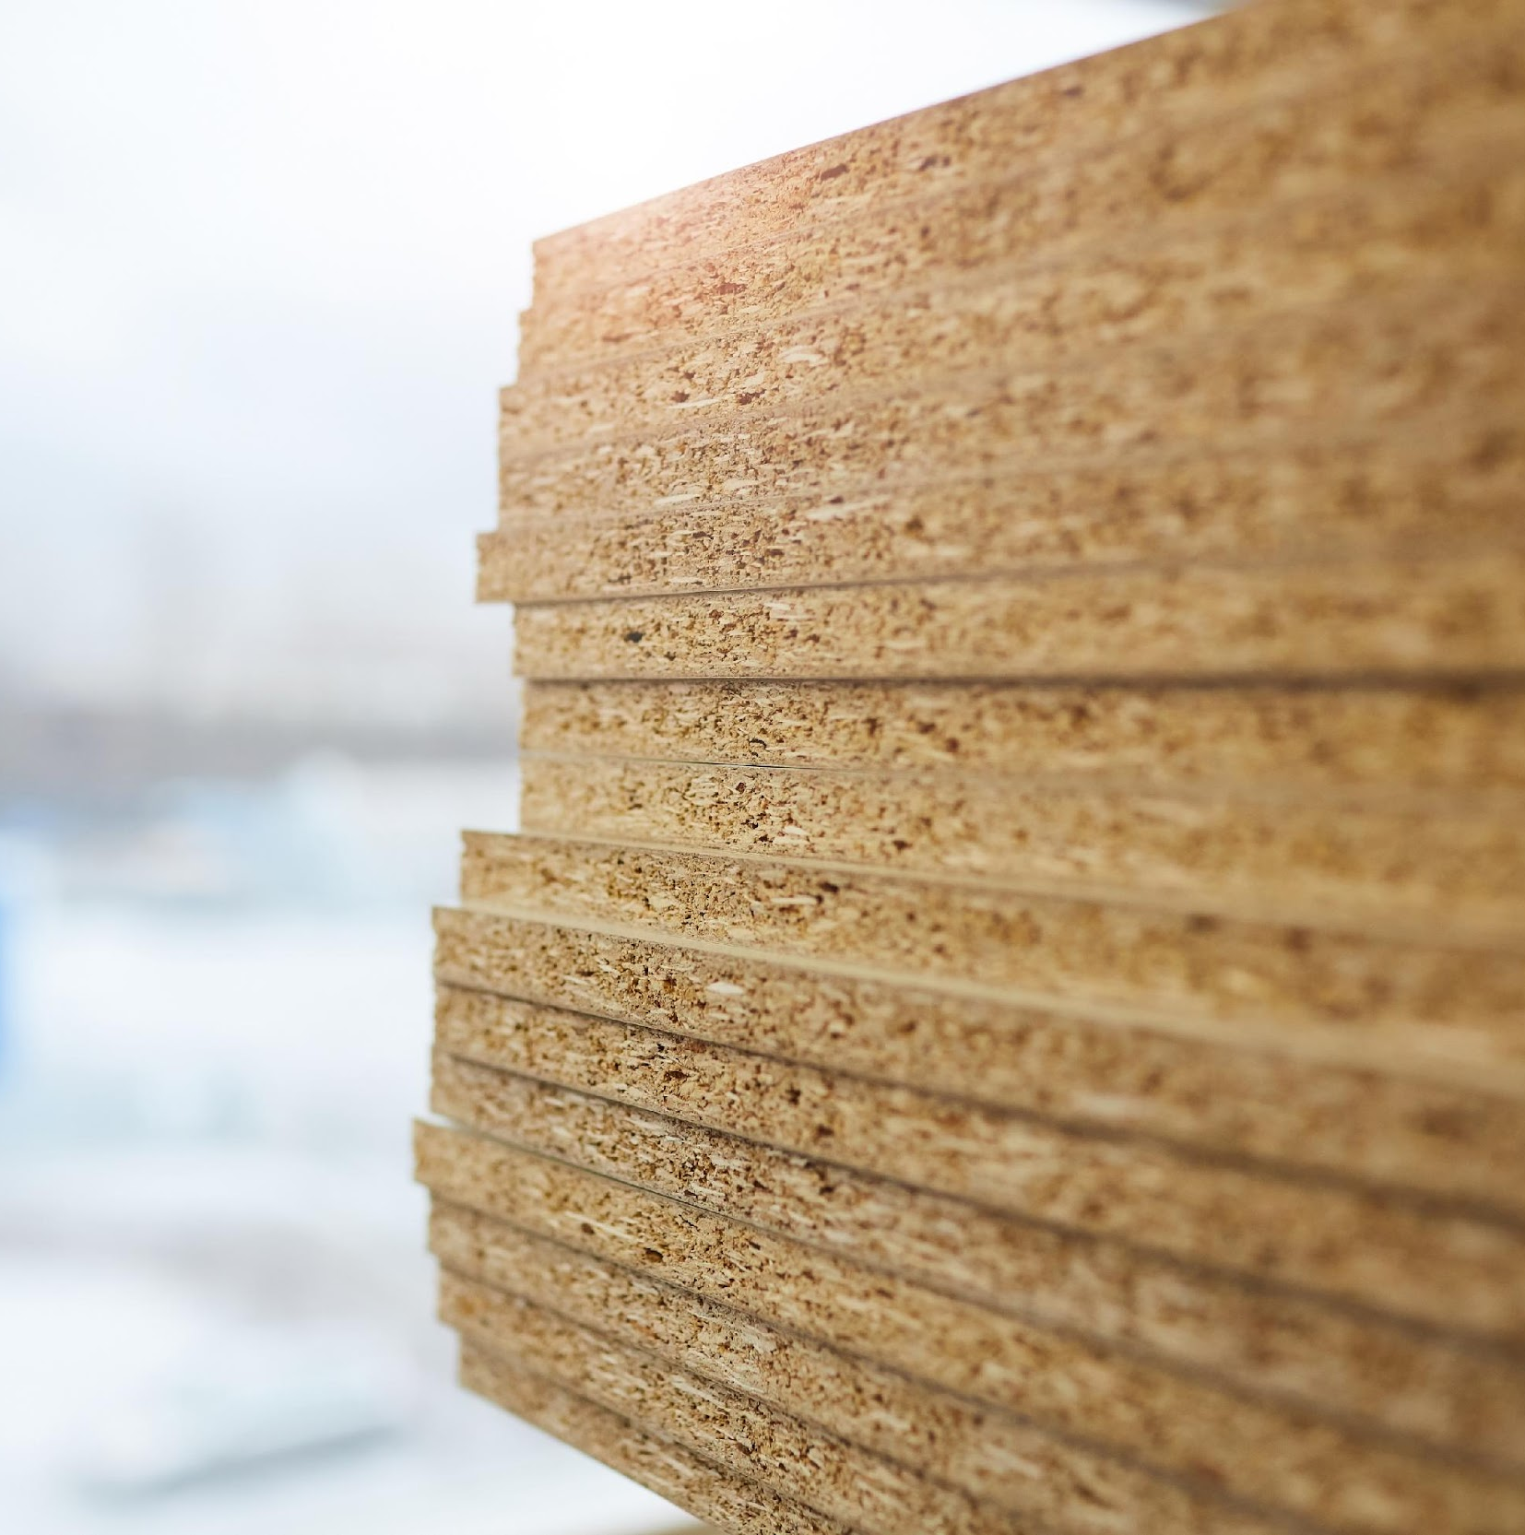
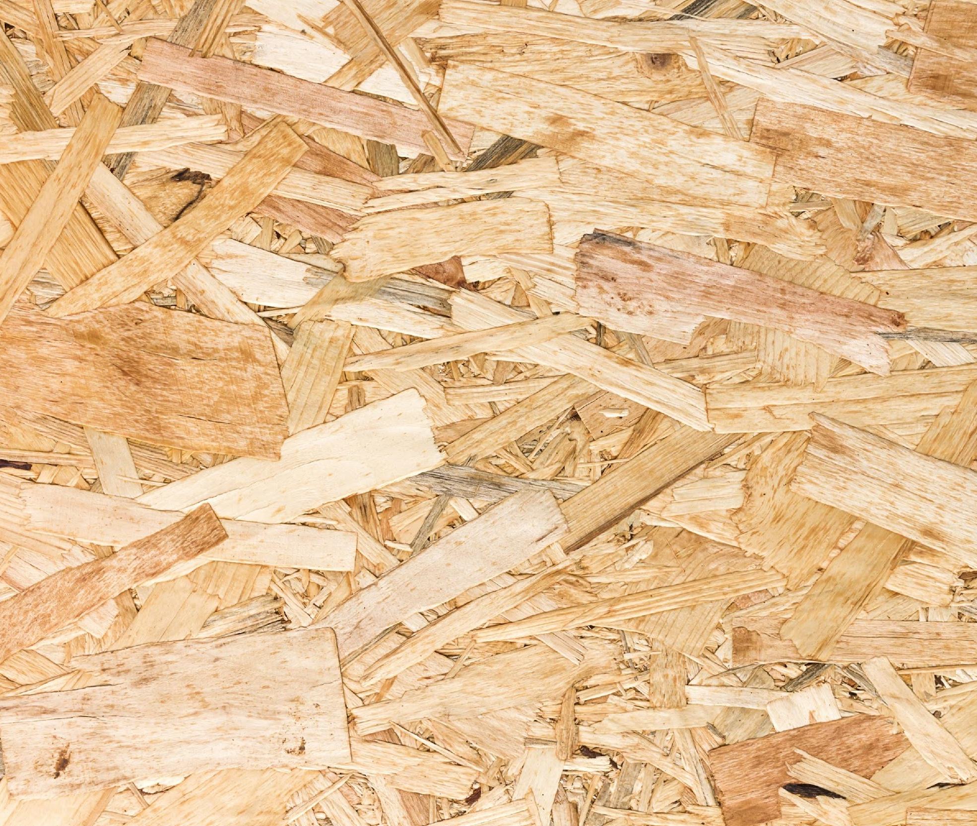
Formaldehyde-based adhesives (UF)
Formaldehyde is a chemical used to make adhesives 90% of the engineered wood (furniture) uses formaldehyde-based (UF) adhesives
Notes:
I am particularly talking about adhesives that we use to make engineered wood boards (Ikea boards) which you might even have at home. So what´s the problem what adhesive made of formaldehyde? so if you have an ikea board at home, that has been made with wood and some sort of formaldehyde based adheseive. The type that everyone has at home. Engineered wood is one of the fundamental materials of the modern built environment.
Used for construction applications and to make furniture

Slide 5
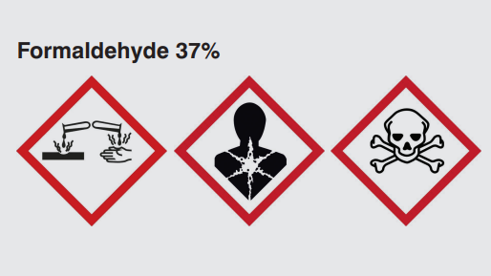
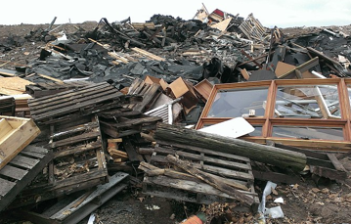
The Problems
Health problem
One of 5 greatest indoor pollutants.
EU's SCHER committee “one of the top five toxic pollutants that should be removed from production”
Environmental problem
Heavy CO2 footprint
Final wood products cannot be recycled
Notes:
Health problem
Formaldehyde is one of the 5 greatest indoor pollutants.
It has been identified by the EU's Scientific Committee on Health and Environmental Risks (SCHER) committee as one of the top five toxic pollutants that should be removed from production

Slide 6
The Solution
BindEthics Bio-adhesive is
Sustainable Non-toxic Not derived from fossil fuels Biodegradable

Slide 7
First Circular Engineered Wood
If we replace UF adhesives with a biobased alternative, engineered wood products would be completely sustainable becoming part of the circular economy cycle
Notes:
If we replace UF adhesives with a biobased alternative, engineered wood products would be completely sustainable becoming part of the circular economy cycle. This is our unique selling point, for a market that moves 240 bn pound a year.

Slide 8
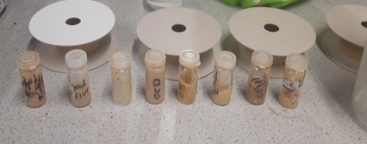
How could this be adopted in the art world? Crates, stands, shelves, frames, single-use products Challenges in bringing this to market? Manufacturers resistance to change
Plan to overcome this challenge
1. Case study
Partnering up with art organizations, artists or museums
2. Costumer awareness
Current support
This project has been partially funded by the forestry commission. We are looking for a formulation to be effective on UK-grown wood
Notes:
Interested in partnering up with art organizations and artists and supply small amounts of engineered wood with our bio-adhesives that artists or museums could use for an exhibition or a small show. Changing mindset, highlighting sustainable product via power of the art world, leading other industries to change too

