Slide 1
Getting Climate Control Under Control
Pilot

Slide 2
Climate Control Pilot
Climate control is one of the most carbon intensive aspects of the cultural sector. But action requires a collective, holistic, international approach.
The science has been there for years. No one is against touching the dial, but no one wants to do it by themselves.
With the climate emergency upon us and the imminent energy crisis, it is time to act now. Together.

Slide 3
The Pilot
50 museums across North America and Europe
18 month program
Tailored climate control adjustment plan and implementation
Includes:
Ki Futures Getting Climate Control Under Control Pilot
Bespoke coaching, training, and support to guide participants through the process of adjusting their climate control conditions and loan agreements
Full access to the Ki Futures Program
International networks and broader sustainability training
Subscription to ArtiCheck Digital Condition Reporting
Training and consistent reporting
Conserv data loggers
Data collection, interpretation and comparison

Slide 4
Goals & Outcomes
To collectively reduce the carbon footprint of the cultural sector
To showcase how to address climate control for museums around the world
Produce 50 case studies
Produce a methodology for museums globally
Data collection and transparency across the sector
Rewriting loan agreements to make international collaborations more accessible and environmentally friendly

Slide 5
Save between 24-82%!
“Museums could save around 24-25% on energy costs just by making minor adjustments to temperature and humidity.” ArtEvolve Webinar
“Maximum savings, compared to a reference situation, of 82% may be achieved. However, the optimum strategy yields a saving of 77%, significantly improves thermal comfort and decreases chemical degradation.” TU Delft
“ASHRAE (2015) Class AA saved 49%, Class A saved 63% of energy compared to the reference class.” Science Direct
“Allowing your limits to increase (say from +/- 6% RH to +/- 12% RH) could halve your energy costs!” KeepSafe
“The Department of Energy estimates savings of about 1 percent for each degree of thermostat adjustment per 8 hours.” Department of Energy Blog

Slide 6
Timeline - Getting Ready
January 2023: Launch of Pilot
Kick Off Meeting
Introduction for Participants
Forming the team
Teams will need representation from various departments - your Coach will help determine who needs to be on your team
January - March
First individual meetings with Coaches
Outline of journey: parameters for the pilot
Chose a space
Set a timeline and map your journey
Courses and workshops
Uploading data and condition reports

Slide 7
Timeline - During the Journey
April 2023 - May 2024
Making changes*
Monthly meetings with your Regional Network
Bi-monthly one-on-one meetings with your Coach
Bi-monthly condition reports
Data collection and analysis
Peer-to-peer learning and exchange
Continued courses and workshops
PLEASE NOTE time and type of changes are unique to each participant - dependent on the institution, the recommendations from the Coach, the conditions at the institution, and the individual timetable. Start dates for “flipping the switch” may vary.

Slide 8
Timeline - Results
June 2024
Final condition reports and assessment
Group methodology discussion
July 2024
International Climate Control Conference - Part II
Presentation of case studies
Presentation of methodology
Invitation for all museums to join the movement!

Slide 9
Courses and Workshops
Special courses and workshops will be provided for participants. Topics for the first three months include*:
Deep Dive: Preventive Conservation
Facilities Management 101
Climate Control for museums - guidelines and outlines
HVAC Systems
Microclimates
Loan Agreements Workshop
Building Survey Workshop
ArtiCheck Training - condition reporting
Conserv Training -
*topics subject to change

Slide 10
Regional Network Meetings
Regional Network Meetings (RNM) are monthly meetings with your Coach and other participants in your country. These meetings offer the opportunity for you to share your experiences and hear how things are going with your colleagues.
Peer-to-peer learning and exchange
Monthly check-in with your Coach and other participants
Get regionally specific information and advice
Local guest speakers and experts

Slide 11
One-on-One Meetings
Every other month, you will have a one-on-one meeting with your Coach to check in and assess how things are going and what next steps are.
One-on-one meetings are for all Champions at your museum
Please bring your latest data and condition reports to your Coach or upload them to the Ki Port before your meeting!

Slide 12
Ki Coaches
Unique Coaches for the Getting Climate Control Under Control Pilot have been brought into the Ki Futures program to work directly with you on your climate control journey.
CC Ki Coaches are specialists in preventive conservation, building management, facilities management, sustainable preservation, preventive conservation, and sustainability. They have extensive experience helping institutions address their energy savings and climate control issues.
Your Coach is here to guide your individual climate control journey - from offering advice and tailoring your timeline to answering questions and providing expertise. Your Coach will be there every step of the way to ensure you are supported and on the right track!

Slide 13
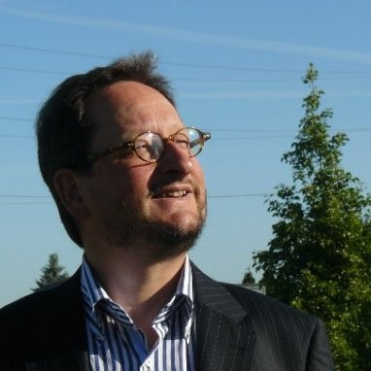
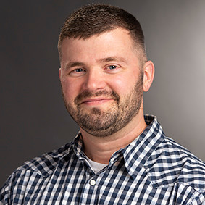
Joel Taylor, PhD
Preventive conservator specializing in sustainable preventive conservation and management of museum environments.
Krijn Braber, Senior strategic consultant at Infinitus
Sustainable energy consultant specializing in strategic processes, organisational and technical aspects of renewable energy projects.
Christopher Cameron, CEM
Facilities and museum environmental specialist and sustainable preservation specialist

Slide 14
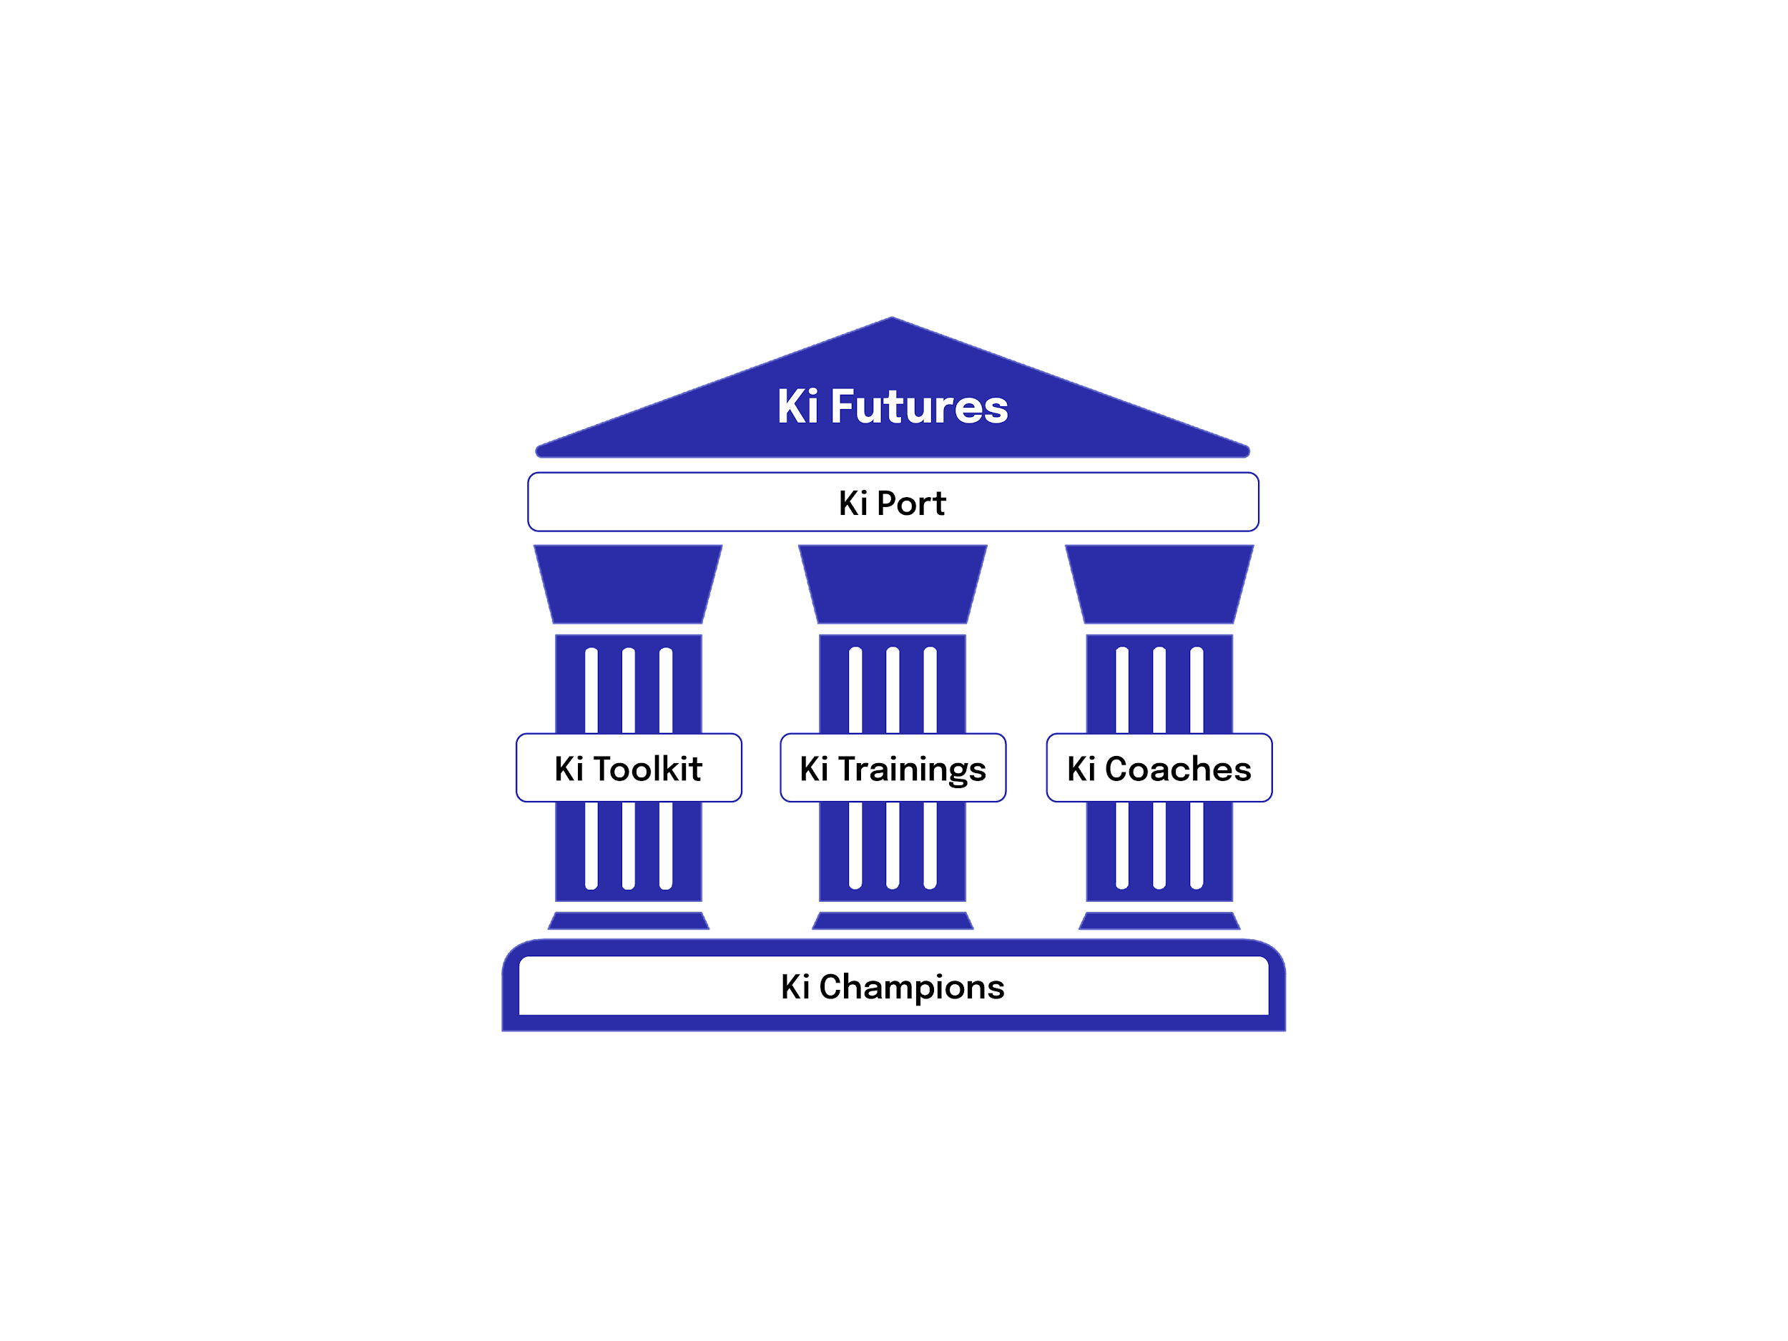
Partner - Ki Futures
Ki Futures
Ki Futures is the international coaching and training network for sustainability in the cultural sector. The program includes:
Weekly Events
Trainings, courses, workshops and networking events
Membership to the Ki Port
Online toolkit, resources, and communication platform
Learn about all aspects of sustainability, including decolonization, carbon footprinting, circular economy, digitization, social and climate justice and more!
An international community of thought-leaders
including the Smithsonian, the National Museum of Lagos, the Museo Moderno, Buenos Aires, the Bishop Museum, the Estonian Art Museum and more!
https://www.kiculture.org/ki-futures/

Slide 15
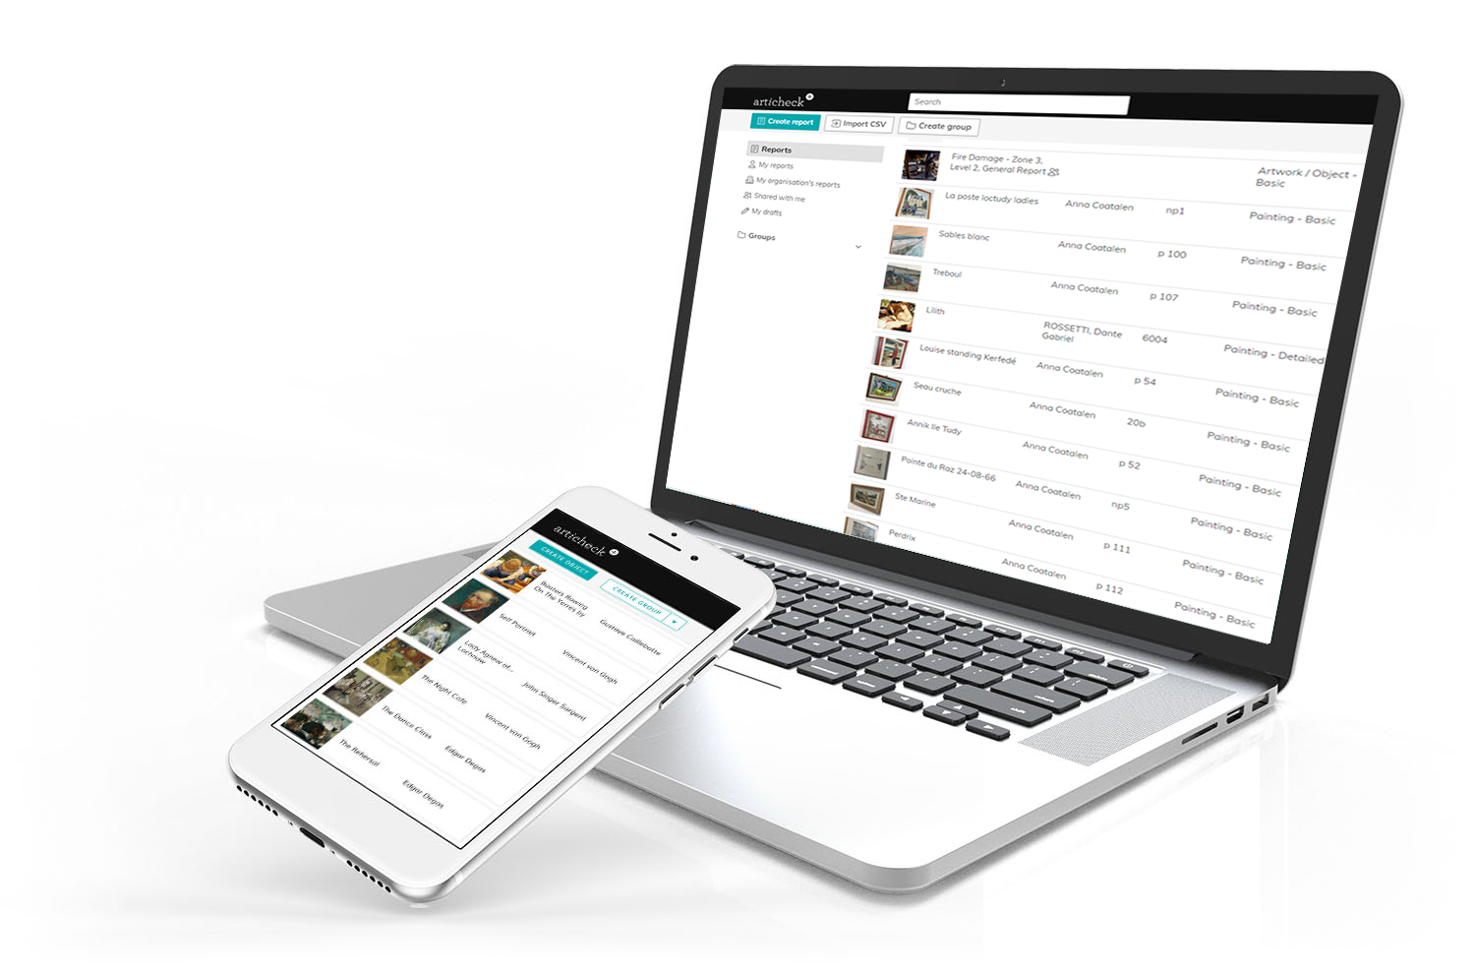
Partner - ArtiCheck
Subscription for consistent reporting and ability to compare results
Training on how to use the system for the project
Consultation on how to achieve the best summary project report via an integration with sensors used and Conserv, as a key outcome and deliverable of the project
Development based on the consultation
https://www.articheck.com/

Slide 16
Partner - Conserv
Conserv is an environmental monitoring subscription trusted by over 300 collections worldwide. We deliver continuous, automated data collection and analysis backed by a team of preservation professionals so you can manage your collection environment with confidence.
What’s included in the Climate Control Pilot Program
5 wireless, LoRaWAN sensors (Temp, RH, Light)
Unlimited access to Conserv Environment and IPM software
Training and support from Conserv’s preservation team
https://conserv.io

Slide 17
How to Sign Up
The Pilot runs from January 2023 - June 2024 with the final conference in July 2024. Due to the structure of the program, participants cannot join the Pilot after the start date.
Requirements for participation:
At least 1 year of RH and T data (as of January 2023)*
Sign off from upper management to adjust climate control settings**
Champions from relevant departments***
Each participant may have up to 10 Champions
Apply here!
After signing Participation Agreement, you will receive your Ki Port Registrations and an invitation for the Kick Off Meeting in January
*if you don’t have the data necessary, please contact us and we can help find solutions!
**if you don’t have buy-in from your upper management, please contact us and we can help!
***this may vary based on participant - single departments, ie. the conservation department, cannot join

Slide 18
Why this works…
A collective problem needs a collective solution…
The science is there… so why haven’t we made the change?
Climate control adjustments not only affect our collections, but are currently required for international loans and insurance policies. Making a change at one institution can single them out. This is why collective action is needed.
The Getting Climate Control Under Control Pilot recognizes that in order for one institution to make changes, we have to all change. If all museums relax their standards and also relax their loan agreements, then there won’t be any barriers to better practice and continued international collaboration.
Changing our conditions can be scary - this is why we need support and guidance - and each other! By working together and having the support from world-renowned experts, the changes are not only backed by science, but collectively agreed upon by our peers globally.
ICCC will address loan agreements and the taboos behind adjustments

Slide 19
Join us!
Interested? Apply here or contact us at kifutures@kiculture.org
Ki Culture
@ki_culture
ki-culture
@KiCulture_

